Slide 1
The Strategic Development of the Department of Computing & Creative Practices over the next five years and [my] role in executing it
John Kelleher

Slide 2
Backdrop
5 years since Hunt
core expenditure/student down 15%
funding cuts 20%
2,000 reduction in staff, 10% drop
staff-student ratio 1:15 to 1:19.5
25,000 extra students
Notes:
It’s not because things are difficult that we do not dare to venture, it’s because we not dare that things are difficult

Slide 3
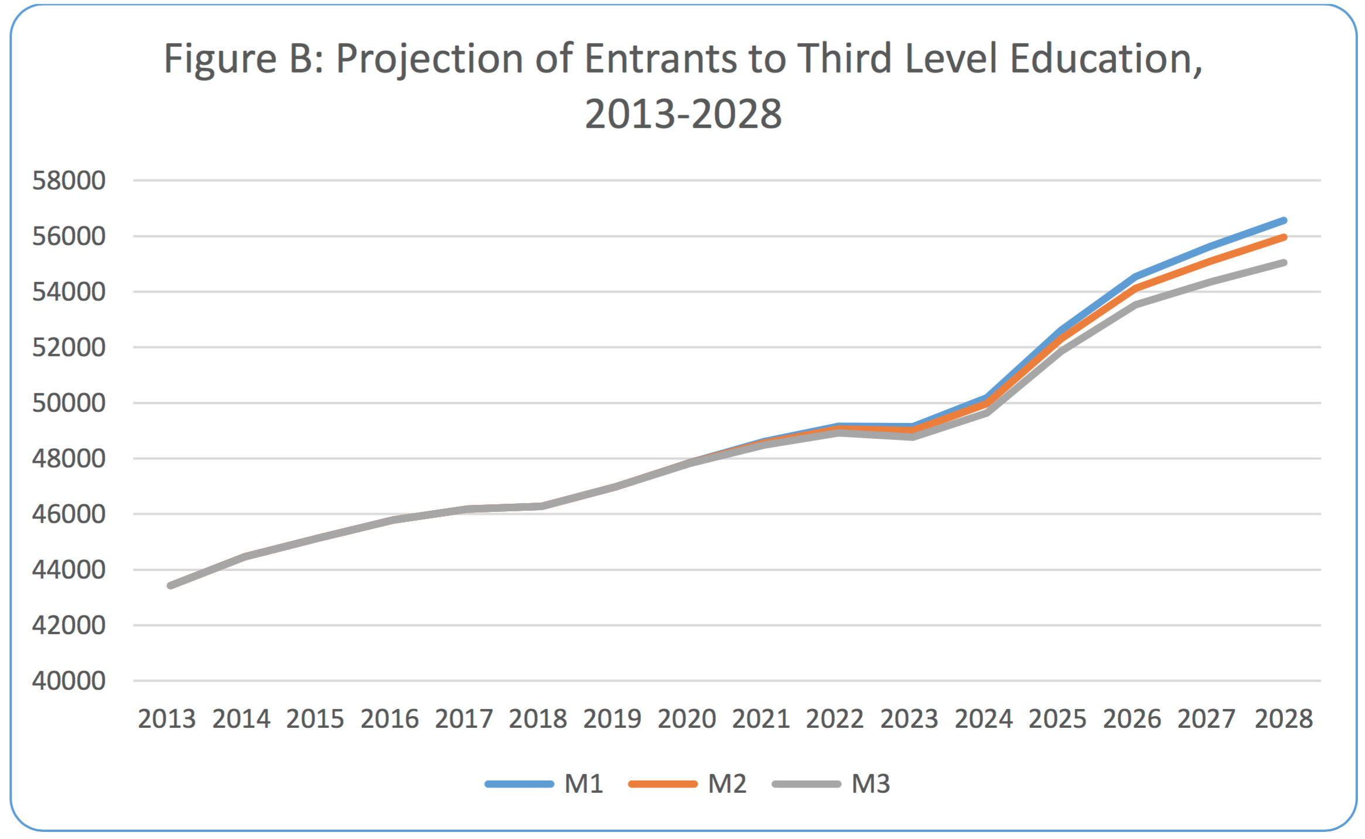
Notes:
Source: DoES: PROJECTIONS OF DEMAND FOR FULL TIME THIRD LEVEL EDUCATION, 2014 – 2028.
2nd Level Enrollment: 333,213 in 2013 to a peak of almost 405,000 in 2025 – 64% will transfer to 3rd level. 3000 new entrants over 5 years

Slide 4
Future considerations
Highest EU tertiary achievement in 30-34
75% employers satisfied – challenges post-graduate development
ICT Skills Action Plan 2014–18 falls short
National Access Plan 2015-19
pathways
Concerns around quality - ‘real risk’ (HESP 2014-16)
Meet Performance Compact with HEA
Progression rates
Engage with ISSE/NFETL
Notes:
Tertiary achievement of 51% in 30-34 age group, target of 60% for 2020, growth of 11% over term of compact (with HEA), same through
Destination survey shows 100% Computing in employment, 60% in Creative
Expert Group on Future Skills Needs, Addressing Future Demand for High-Level ICT Skills, Nov 2013: 7000 new ICT jobs/annum
ICT Skills Action Plan 2014–18: 2014 met 63% of need
National Plan for Equity of Access to Higher Education 2015-2019
Higher % students on grants, sensitive to future funding changes, 64% ITS, 71% LYIT, often 1st generation students – 26% from disadvantaged socio-economic groups
Secure equity of access – mobilise talent from all parts, disabled, mature, first-time, part-time, online – uniquely positioned to benefit ITS
Higher Education System Performance 2014-16 First Report – cautions around quality
Performance Compact – HEA funding implications contingent upon performance criteria being established now.
Non-Progression 23% in 2013/14

Slide 5
Student Experience
Notes:
Direction is more important than speed
Chosen to focus on 2 key aspects (student & staff experience) rather than n strategic pillars

Slide 6
Student Experience
Excellence in T,L&A a keystone of performance
ISSE shows 1st years have lowest level of engagement
traditional contact hours foster dependency – flip classroom
manage transition to independent/peer learning/PBL
need xtra-mural activities - contribute
improve feedback mechanisms
Form career plans, e-Portfolio, ‘outduction’
Soft skills important - critical thinking, problem solving, team work
Notes:
Education is not the filling of a pail, but the lighting of a fire. W.B. Yeats
Teaching Expert Team Awards (NFETL 2015)
Non-Progression 23% in 2013/14
Nurture independence, not dependence
Ownership over education, peer supported learning centre, ICT Learning Centre (Michael English & Hussain Mahdi, UL)
Form career plans – educate about market sectors e.g. Pramerica outduction
Men with HE 69% increase earnings, women 90%improved health, job satisfaction, pass along appreciation for education
Open days, project presentations, community involvement

Slide 7

Retire into yourself as much as possible.
Associate with people who are likely to improve you. Welcome those whom you are capable of improving. The process is a mutual one.
People learn as they teach.
- Seneca
Introspection
Notes:
Direction is more important than speed

Slide 8
Staff Experience
Focus & Reflection
Professional doctorates
Kaizen / CPD
Revitalise Programme Boards
Fix research pipe-line -> fix research
Computing meet COL (Centre for Online Learning)
Ambassadors through research, community engagement, scholarship
Foster an Identity for C&CP
Notes:
Kaizen
Focus – identify and invest in specific sub-disciplines (e.g. software) with degree of certainty
Reflect – more closely monitor market & our offering
Computing meet COL – for both technology upshift and upskilling

Slide 9
Action Specifics
Reconsider exclusive focus on Microsoft (Software/Web/Games)
Consolidate expertise & appraise market shifts
Web development programme
Encourage shift in focus (Creative Design) to support better deployment
Targeted community engagement
projects, businesses/NFPs, Erasmus+, CoderDojo, CTY
Attract life-long learners and minorities – IT camps, minor awards, AFU, ‘A Taste of ITS’
Promote professionalism - department blog (‘water-cooler’ effect), research activities - underwrite our relevancy
Graduate survey & follow-up
Notes:
Appetite in CD to move from industrial design to UX
ILP Intergenerational learning – DCU, Age Friendly University (2012)

Slide 10

Fintech
Notes:
Direction is more important than speed

Slide 11
Fintech
Technology meets Finance
Neglected opportunity
IFS2020 (2015-2020)
Established and growing
Tradition of Business
Leverage existing expertise and relationships
Broaden computing offering
Notes:
Use disruptive technology and innovation to change the way financial transactions take place.
FinTech (Source: IFS2020, Mar ’15). Major conf next Mar. Minister Simon Harris predicts 5000 new jobs over 5 years.
CURRENT: 400 companies (200 Irish) 1/3 outside Dublin; 35,000 jobs (100,000 in ICT); 4th largest exporter of financial services in EU; Paypal 2500 workers
NEW JOBS 330 jobs Pramerica (David Roche) off 1200 currently; 300 fintech jobs (over 3yrs) at Northern Trust in Limerick and Accenture (Fintech Innovation Lab) plans to hire 250 people, 500 at PwC
Recent BB in Finance & Investment L8

Slide 12

Internet of Things
Notes:
Direction is more important than speed

Slide 13
Internet of Things
Technology meets physical world
‘Smart’ homes/cars/cities/bodies
‘Second major revolution’ – Philip Moynagh, Intel’s VP for IoT
Tremendous growth projections
DCU Alpha, WIT
Aligns with Dept. Mech & Elec. Engineering
Underway
Notes:
Innovation Voucher Cow weight
Internet of Screens -> Internet of Things
Largest device market in the world – greater than combined smartphone, PC, tablet, connected car & wearable markets.
$1.7 trillion in value added to global economy by 2019
Intel to turn Dublin into world’s first ‘internet of things’ city
Dec New jobs: Asavie 106 jobs, Accenture 200 jobs, DCU Alpha plans to 100 companies & 800 jobs over the next 3 years
Eamonn de Leastar WIT & TSSG
Fergal Henry, SFI application

Slide 14
Questions
John Kelleher, IT Sligo

